Slide 1
Unit 4 Chapter 1 Storage and Querying

Slide 2
Syllabus Topics
Storage and Querying:
Storage and File structures
Indexed Files
Single Level and Multi Level Indexes
Query Processing
Query Optimization

Slide 3
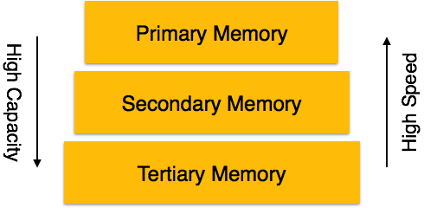
Overview of physical Storage System
A database system provides an ultimate view of the stored data.
However, data in the form of bits, bytes get stored in different storage devices.
Types of Data Storage
Primary Storage: The memory storage that is directly accessible to the CPU comes under this category.
CPU's internal memory (registers), fast memory (cache), and main memory (RAM)
Secondary Storage: Secondary storage includes memory devices that are not a part of the CPU chipset or motherboard. Magnetic disks, hard disks, flash drives.
Tertiary Storage: Tertiary storage is used to store huge volumes of data.
Since such storage devices are external to the computer system, they are the slowest in speed. Optical disks (DVD, CD, etc.), magnetic tapes.
Notes:
How do computers know the time when turned off?
A special kind of system memory called CMOS(Complementary Metal-Oxide-Semiconductor) stores the date and time settings and a computer chip called the Real-Time clock (RTC) then keeps track of time. When the PC is powered off, a battery on the motherboard keeps the CMOS memory and the RTC chip activated so it does not lose time.

Slide 4
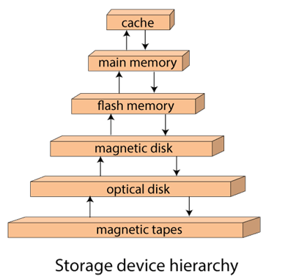
Overview of physical Storage System
The cache is the fastest and most costly form of storage. Cache memory is small; its use is managed by the computer system hardware.
Main memory. The storage medium used for data that are available to be operated on is main memory. The general-purpose machine instructions operate on main memory. Although main memory may contain many megabytes of data, or even gigabytes of data in large server systems, it is generally too small (or too expensive) for storing the entire database.

Slide 5
Overview of physical Storage System
Flash memory. Also known as electrically erasable programmable read-only memory (EEPROM), flash memory differs from main memory in that data survive power failure.
Reading data from flash memory takes less than 100 nanoseconds (a nanosecond is 1/1000 of a microsecond), which is roughly as fast as reading data from main memory.
However, writing data to flash memory is more complicated—data can be written once, which takes about 4 to 10 microseconds, but cannot be overwritten directly. To overwrite memory that has been written already, we have to erase an entire bank of memory at once; it is then ready to be written again.
A drawback of flash memory is that it can support only a limited number of erase cycles, ranging from 10,000 to 1 million.
Flash memory has found popularity as a replacement for magnetic disks for storing small volumes of data (5 to 10 megabytes) in low-cost computer systems,

Slide 6
Overview of physical Storage System
Magnetic-disk storage. The primary medium for the long-term on-line storage of data is the magnetic disk. Usually, the entire database is stored on magnetic disk. The system must move the data from disk to main memory so that they can be accessed. After the system has performed the designated operations, the data that have been modified must be written to disk.
Optical storage. The most popular forms of optical storage are the compact disk (CD), which can hold about 640 megabytes of data, and the digital video disk (DVD) which can hold 4.7 or 8.5 gigabytes of data per side of the disk (or up to 17 gigabytes on a two-sided disk). Data are stored optically on a disk, and are read by a laser
Notes:
Consists of 7 levels
Levels do not imply a hierarchical relationship but designate different design architectures that share three common characteristics:
Set of physical disk drives viewed by the operating system as a single logical drive
Data are distributed across the physical drives of an array in a scheme known as striping
Redundant disk capacity is used to store parity information, which guarantees data recoverability in case of a disk failure

Slide 7
Overview of physical Storage System
Tape storage. Tape storage is used primarily for backup and archival data.
Although magnetic tape is much cheaper than disks, access to data is much slower, because the tape must be accessed sequentially from the beginning.
For this reason, tape storage is referred to as sequential-access storage. In contrast, disk storage is referred to as direct-access storage because it is possible to read data from any location on disk.
Tapes have a high capacity (40 gigabyte to 300 gigabytes tapes are currently available), and can be removed from the tape drive, so they are well suited to cheap archival storage
Notes:
Consists of 7 levels
Levels do not imply a hierarchical relationship but designate different design architectures that share three common characteristics:
Set of physical disk drives viewed by the operating system as a single logical drive
Data are distributed across the physical drives of an array in a scheme known as striping
Redundant disk capacity is used to store parity information, which guarantees data recoverability in case of a disk failure

Slide 8
RAID-Redundant Array of Independent Disks
RAID or Redundant Array of Independent Disks, is a technology to connect multiple secondary storage devices and use them as a single storage media.
RAID consists of an array of disks in which multiple disks are connected together to achieve different goals. RAID levels define the use of disk arrays
Notes:
KORTH- 405 page
Consists of 7 levels
Levels do not imply a hierarchical relationship but designate different design architectures that share three common characteristics:
Set of physical disk drives viewed by the operating system as a single logical drive
Data are distributed across the physical drives of an array in a scheme known as striping
Redundant disk capacity is used to store parity information, which guarantees data recoverability in case of a disk failure

Slide 9
RAID
Consists of 7 levels
Levels do not imply a hierarchical relationship but designate different design architectures that share three common characteristics:
Set of physical disk drives viewed by the operating system as a single logical drive
Data are distributed across the physical drives of an array in a scheme known as striping
Redundant disk capacity is used to store parity information, which guarantees data recoverability in case of a disk failure
Redundant Array of Independent Disks
Notes:
[ Chapter 6 of William stallings]
RAID is a technology that is used to increase performance and/or reliability in data storage.
1. RAID is a set of physical disk drives viewed by the operating system as a single
logical drive.
2. Data are distributed across the physical drives of an array in a scheme known
as striping, described subsequently.
3. Redundant disk capacity is used to store parity information, which guarantees
data recoverability in case of a disk failure.
The details of the second and third characteristics differ for the different RAID
levels. RAID 0 and RAID 1 do not support the third characteristic.
The term RAID was originally coined in a paper by a group of researchers
at the University of California at Berkeley [PATT88]. The paper outlined various
RAID configurations and applications and introduced the definitions of the
RAID levels that are still used. The RAID strategy employs multiple disk drives
and distributes data in such a way as to enable simultaneous access to data from
multiple drives, thereby improving I/O performance and allowing easier incremental
increases in capacity.

Slide 10
RAID Levels
N = number of data disks; m proportional to log N
Notes:
The unique contribution of the RAID proposal is to address effectively the
need for redundancy. Although allowing multiple heads and actuators to operate
simultaneously achieves higher I/O and transfer rates, the use of multiple devices
increases the probability of failure. To compensate for this decreased reliability,
RAID makes use of stored parity information that enables the recovery of data lost
due to a disk failure.
We now examine each of the RAID levels. Table 6.3 provides a rough guide
to the seven levels. In the table, I/O performance is shown both in terms of data
transfer capacity, or ability to move data, and I/O request rate, or ability to satisfy
I/O requests, since these RAID levels inherently perform differently relative to
these two metrics. Each RAID level’s strong point is highlighted by darker shading.

Slide 11
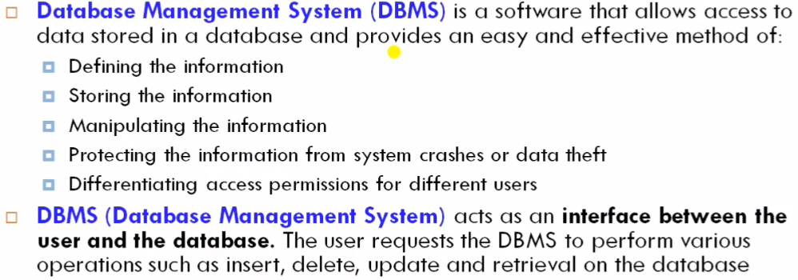
DBMS

Slide 12
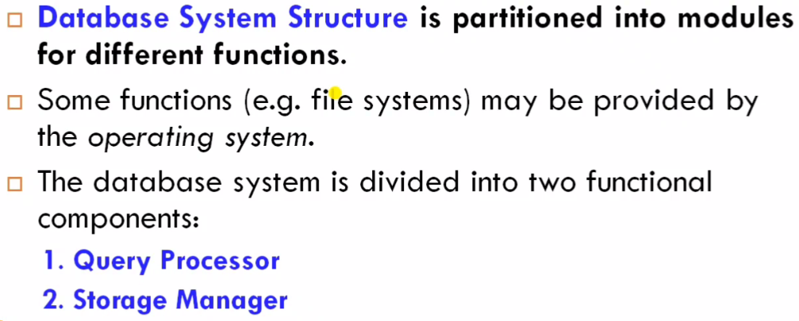

Slide 13
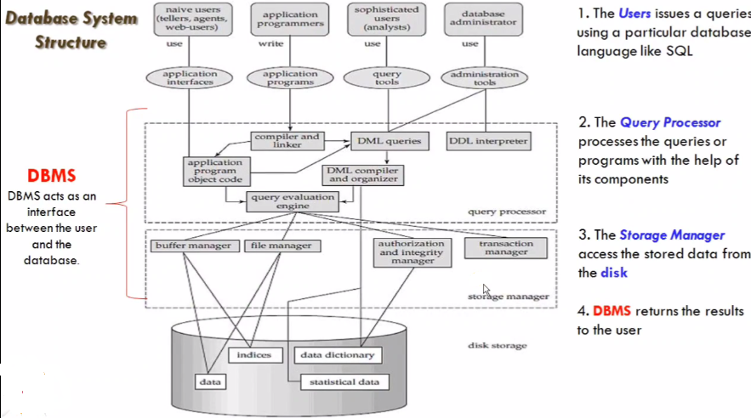

Slide 14
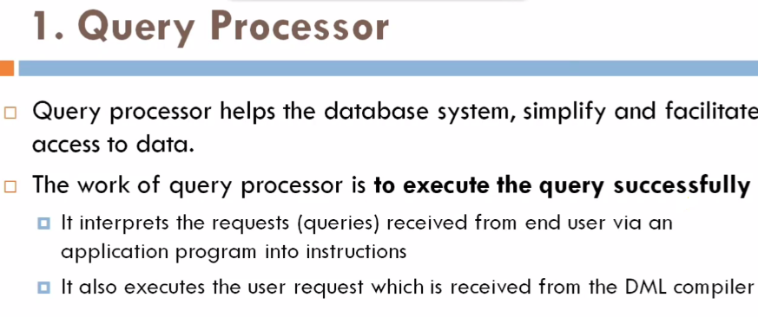

Slide 15
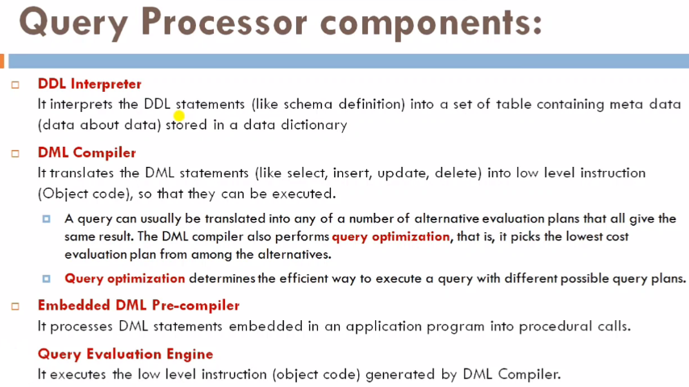

Slide 16
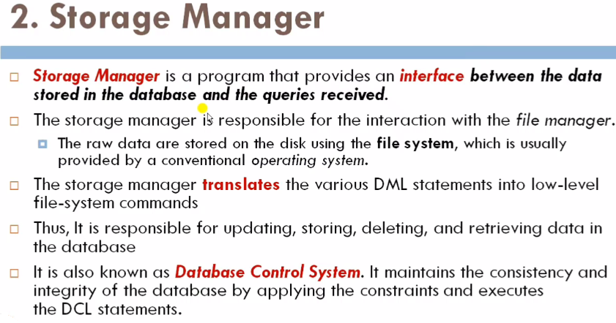

Slide 17
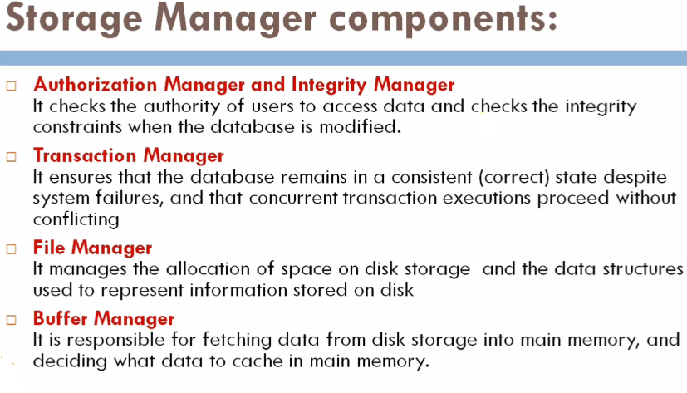

Slide 18
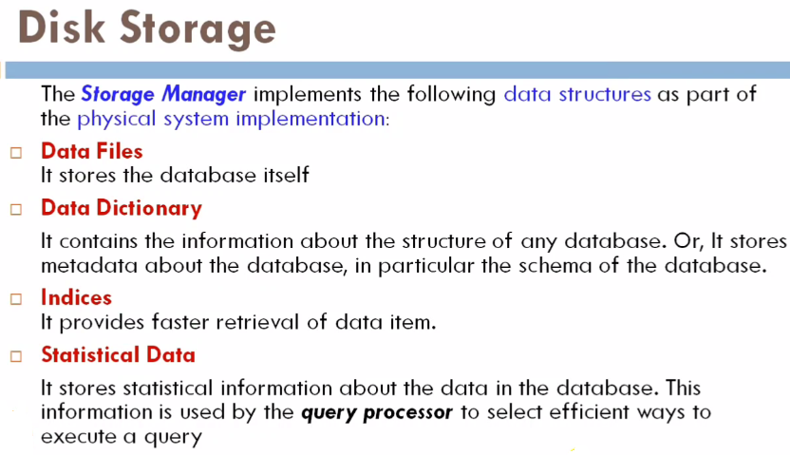

Slide 19
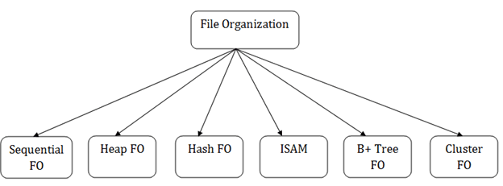
File Structures
The File is a collection of records. Using the primary key, we can access the records.
OR
A file is named collection of related information that is recorded on secondary or tertiary storage such as magnetic disks, magnetic tapes and optical disks.
The type and frequency of access can be determined by the type of file organization which was used for a given set of records.
File organization is a logical relationship among various records.
This method defines how file records are mapped onto disk blocks.
File organization is used to describe the way in which the records are stored in terms of blocks, and the blocks are placed on the storage medium.
Notes:
What is File Organization? File Organization refers to the logical relationships among various records that constitute the file, particularly with respect to the means of identification and access to any specific record. In simple terms, Storing the files in certain order is called file Organization. File Structure refers to the format of the label and data blocks and of any logical control record.

Slide 20
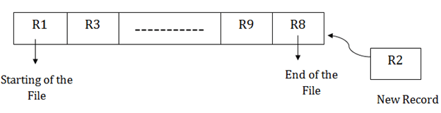
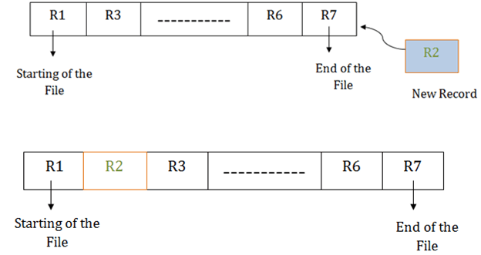
File Structures- Sequential method
Pile File Method:
In this method, we store the record in a sequence, i.e., one after another. Here, the record will be inserted in the order in which they are inserted into tables.
Sorted File Method:
In this method, the new record is always inserted at the file's end, and then it will sort the sequence in ascending or descending order. Sorting of records is based on any primary key or any other key.
In the case of modification of any record, it will update the record and then sort the file, and lastly, the updated record is placed in the right place.
Notes:
Limitations:
Time wastage as we cannot jump on a particular record that is required, but we have to move in a sequential manner which takes our time.
Sorted file method is inefficient as it takes time and space for sorting records.

Slide 21
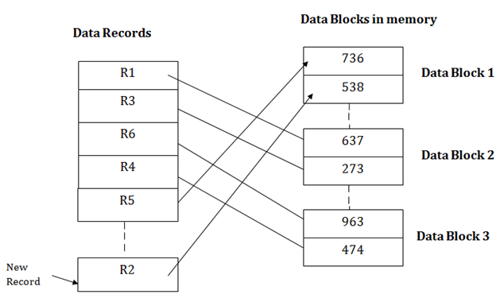
File Structures
Heap file organization
It works with data blocks.
When the records are inserted, it doesn't require the sorting and ordering of records.
When the data block is full, the new record is stored in some other block.
This new data block need not to be the very next data block, but it can select any data block in the memory to store new records.
suppose we want to insert a new record R2 in a heap.
If the data block 3 is full then it will be inserted in any of the database selected by the DBMS, let's say data block 1.

Slide 22
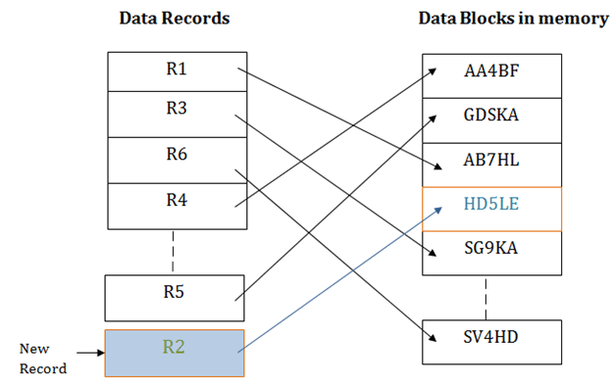
File Structures
Hash File Organization
Hash File Organization uses the computation of hash function on some fields of the records. The hash function's output determines the location of disk block where the records are to be placed.
When a record has to be retrieved using the hash key columns, then the address is generated, and the whole record is retrieved using that address.
In the same way, when a new record has to be inserted, then the address is generated using the hash key and record is directly inserted. The same process is applied in the case of delete and update.

Slide 23
File Structures
Cluster file organization
When the two or more tables/records are stored in the same file, it is known as clusters.
These files will have two or more tables in the same data block, and key attributes which are used to map these tables together are stored only once.
The cluster file organization is used when there is a frequent need for joining the tables with the same condition.
In this method, we can directly insert, update or delete any record. Data is sorted based on the key with which searching is done. Cluster key is a type of key with which joining of the table is performed.
Notes:
In cluster file organization, two or more related tables/records are stored within same file known as clusters. These files will have two or more tables in the same data block and the key attributes which are used to map these table together are stored only once.
Thus it lowers the cost of searching and retrieving various records in different files as they are now combined and kept in a single cluster.

Slide 24
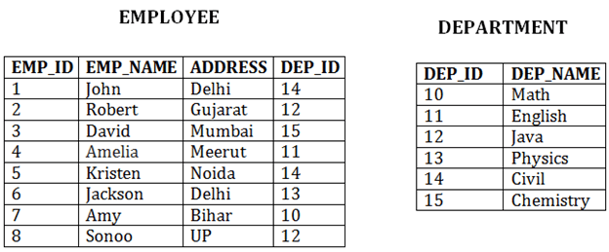
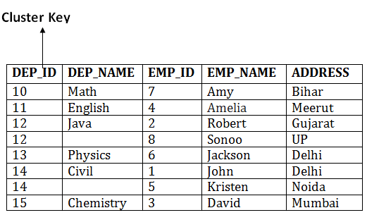
File Structures
In the given example, we are retrieving the record for only particular departments.
Types of Cluster file organization:
1. Indexed Clusters:
In indexed cluster, records are grouped based on the cluster key and stored together. The EMPLOYEE and DEPARTMENT relationship is an example of an indexed cluster. Here, all the records are grouped based on the cluster key- DEP_ID and all the records are grouped.
2. Hash Clusters:
It is similar to the indexed cluster. In hash cluster, instead of storing the records based on the cluster key, it generate the value of the hash key for the cluster key and store the records with the same hash key value.

Slide 25
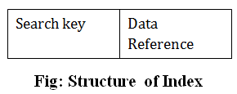
Indexing
Indexing is used to optimize the performance of a database by minimizing the number of disk accesses required when a query is processed.
Index structure:
Indexes can be created using some database columns.
The first column of the database is the search key that contains a copy of the primary key or candidate key of the table. The values of the primary key are stored in sorted order so that the corresponding data can be accessed easily.
The second column of the database is the data reference. It contains a set of pointers holding the address of the disk block where the value of the particular key can be found.

Slide 26
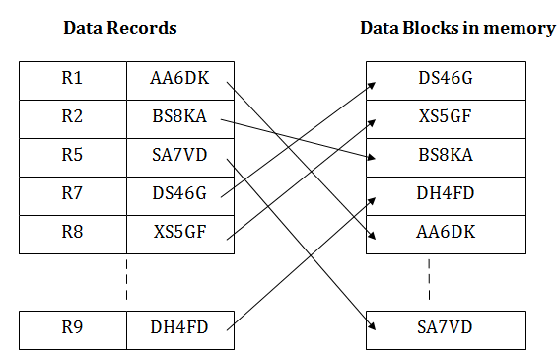
File Structures
Indexed sequential access method (ISAM)
ISAM method is an advanced sequential file organization. In this method, records are stored in the file using the primary key.
An index value is generated for each primary key and mapped with the record. This index contains the address of the record in the file.
If any record has to be retrieved based on its index value, then the address of the data block is fetched and the record is retrieved from the memory.
Notes:
Pros of ISAM:
In this method, each record has the address of its data block, searching a record in a huge database is quick and easy.
This method supports range retrieval and partial retrieval of records. Since the index is based on the primary key values, we can retrieve the data for the given range of value. In the same way, the partial value can also be easily searched, i.e., the student name starting with 'JA' can be easily searched.
Cons of ISAM
This method requires extra space in the disk to store the index value.
When the new records are inserted, then these files have to be reconstructed to maintain the sequence.
When the record is deleted, then the space used by it needs to be released. Otherwise, the performance of the database will slow down.

Slide 27
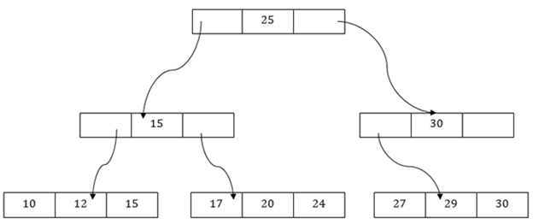
File Structures
B+ File Organization
B+ tree file organization is the advanced method of an indexed sequential access method. It uses a tree-like structure to store records in File.
It uses the same concept of key-index where the primary key is used to sort the records. For each primary key, the value of the index is generated and mapped with the record.
In this method, all the records are stored only at the leaf node. Intermediate nodes act as a pointer to the leaf nodes. They do not contain any records.
There is one root node of the tree, i.e., 25. There is an intermediary layer with nodes. They do not store the actual record. They have only pointers to the leaf node.
The nodes to the left of the root node contain the prior value of the root and nodes to the right contain next value of the root, i.e., 15 and 30 respectively.
There is only one leaf node which has only values, i.e., 10, 12, 17, 20, 24, 27 and 29.

Slide 28
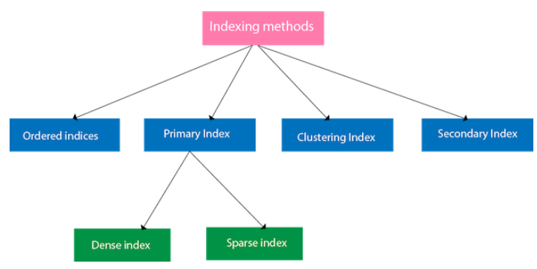
Types of Indexes
Ordered Indexing
The indices are usually sorted to
make searching faster. The indices which are sorted are known as ordered indices.
Example: Suppose we have an employee table with thousands of record and each of which is 10 bytes long. If their IDs start with 1, 2, 3....and so on and we have to search student with ID-543.
In the case of a database with no index, we have to search the disk block from starting till it reaches 543. The DBMS will read the record after reading 543*10=5430 bytes.
In the case of an index, we will search using indexes and the DBMS will read the record after reading 542*2= 1084 bytes which are very less compared to the previous case.

Slide 29
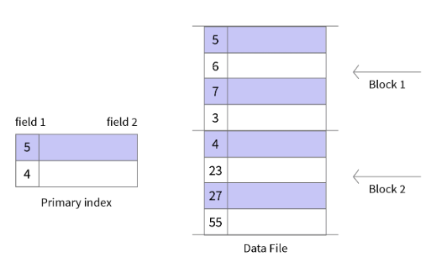
Types of Indexes
Primary Indexing:
If the index is created on the basis of the primary key of the table, then it is known as primary indexing.
These primary keys are unique to each record and contain 1:1 relation between the records.
As primary keys are stored in sorted order, the performance of the searching operation is quite efficient.
Characteristics of Primary Indexing:
Search Keys are unique.
Search Keys are in sorted order.
Search Keys cannot be null as it
points to a block of data.
Fast and Efficient Searching.

Slide 30
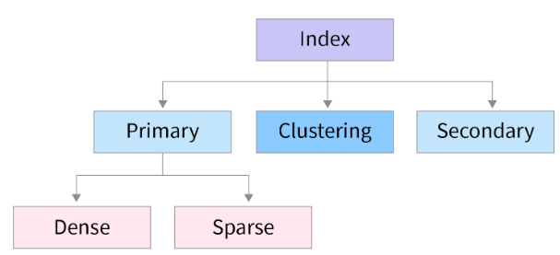
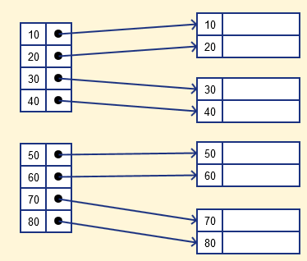
Types of Indexes
The primary Indexing in DBMS is also further divided into two types.
Dense Index
Sparse Index
Dense Index
In a dense index, a record is created for every search key valued in the database.
This helps you to search faster but needs more space to store index records.
In this Indexing, method records contain search key value and points to the real record on the disk.

Slide 31
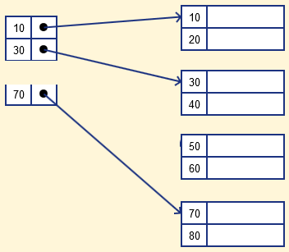
Types of Indexes
Sparse Index
Sparse Index helps you to resolve the issues of dense Indexing in DBMS.
In this method of indexing technique, a range of index columns stores the same data block address, and when data needs to be retrieved, the block address will be fetched.
Sparse Index stores index records for only some search-key values. It needs less space, less maintenance overhead for insertion, and deletions but It is slower compared to the dense Index for locating records.

Slide 32
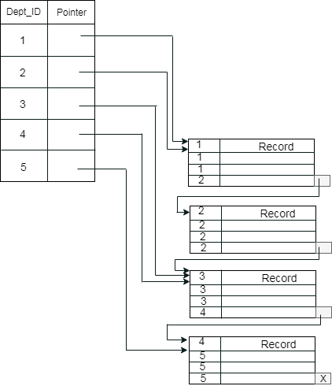
Types of Indexes
Cluster Indexing:
Clustered Indexing is used when there are multiple related records found at one place.
The important thing to note here is that the index table of clustered indexing is created using non-key values which may or may not be unique.
To achieve faster retrieval, we group columns having similar characteristics. The indexes are created using these groups and this process is known as Clustering Index.
Let’s assume that a company recruited many employees in various departments. In this case, clustering indexing in DBMS should be created for all employees who belong to the same dept.
Here, Department _no is a non-unique key.

Slide 33
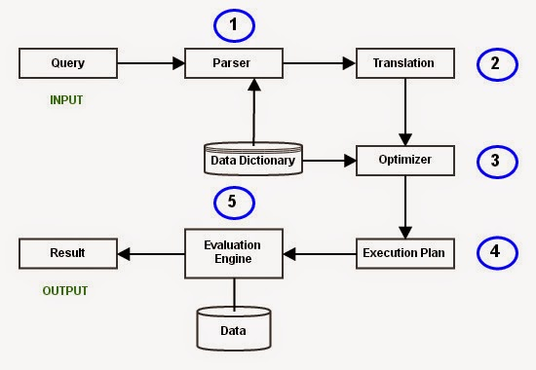
Query Processing and Query Optimization
Query Processing would mean the entire process or activity which involves query translation into low level instructions, query optimization to save resources, cost estimation or evaluation of query, and extraction of data from the database.
Query Processing is a translation of high-level queries into low-level expression.
It requires the basic concepts of relational algebra and file structure.

Slide 34
Query Processing and Query Optimization
Parsing and Translation
The fired queries undergo lexical, syntactic, and semantic analysis.
The query gets broken down into different tokens and white spaces are removed along with the comments (Lexical Analysis).
The query processor first checks the query if the rules of SQL have been correctly followed or not (Syntactic Analysis).
Finally, the query processor checks if the meaning of the query is right or not. Things like if the table(s) mentioned in the query are present in the DB or not? if the column(s) referred from all the table(s) are actually present in them or not? (Semantic Analysis)

Slide 35
Query Processing and Query Optimization
SELECT
emp_name
FROM
employee
WHERE
salary>10000;
Parsing and Translation Example
The above query would be divided into the following tokens:Lexical Analysis)
SELECT, emp_name, FROM, employee, WHERE, salary, >, 10000.
Check for Query syntax: (Syntactic Analysis).
The name of the queried table is looked into the data dictionary table.
The name of the columns mentioned (emp_name and salary) in the tokens are validated for existence.
The type of column(s) being compared have to be of the same type (salary and the value 10000 should have the same data type). (Semantic Analysis)

Slide 36
Query Processing and Query Optimization
SELECT
emp_name
FROM
employee
WHERE
salary>10000;
Parsing and Translation Example
The next step is to translate the generated set of tokens into a relational algebra query. These are easy to handle for the optimizer in further processes.
σ_{salary>10000} (π_{salary} (Employee))
π_{salary} (σ_{salary>10000} (Employee))
After translating the given query, we can execute each relational algebra operation by using different algorithms.
So, in this way, a query processing begins its working.

Slide 37
Query Processing and Query Optimization
Query Optimization
In the next step, DMBS picks up the most efficient evaluation plan based on the cost each plan has.
The aim here is to minimize the query evaluation time. The optimizer also evaluates the usage of index present in the table and the columns being used.
It also finds out the best order of subqueries to be executed so as to ensure only the best of the plans gets executed.
Simply put, for any query, there are multiple evaluation plans to execute it. Choosing the one which costs the least is called Query Optimization.

Slide 38
Query Processing and Query Optimization
Query Optimization
Some of the factors weighed in by the optimizer to calculate the cost of a query evaluation plan is:
CPU time
Number of tuples to be scanned
Disk access time
number of operations

Slide 39
Query Processing and Query Optimization
Execution Plan
A query can be expressed in many ways.
The query processor module, at this stage, using the information collected in Optimization step to find different relational algebra expressions that are equivalent and return the result of the one which we have written already.
So far, we have got two execution plans. Only condition is that both plans should give the same result.

Slide 40
Query Processing and Query Optimization
Query execution engine
A query execution engine is responsible for generating the output of the given query.
At this stage, we choose one execution plan of the several we have developed.
This Execution plan accesses data from the database to give the final result.

Slide 41
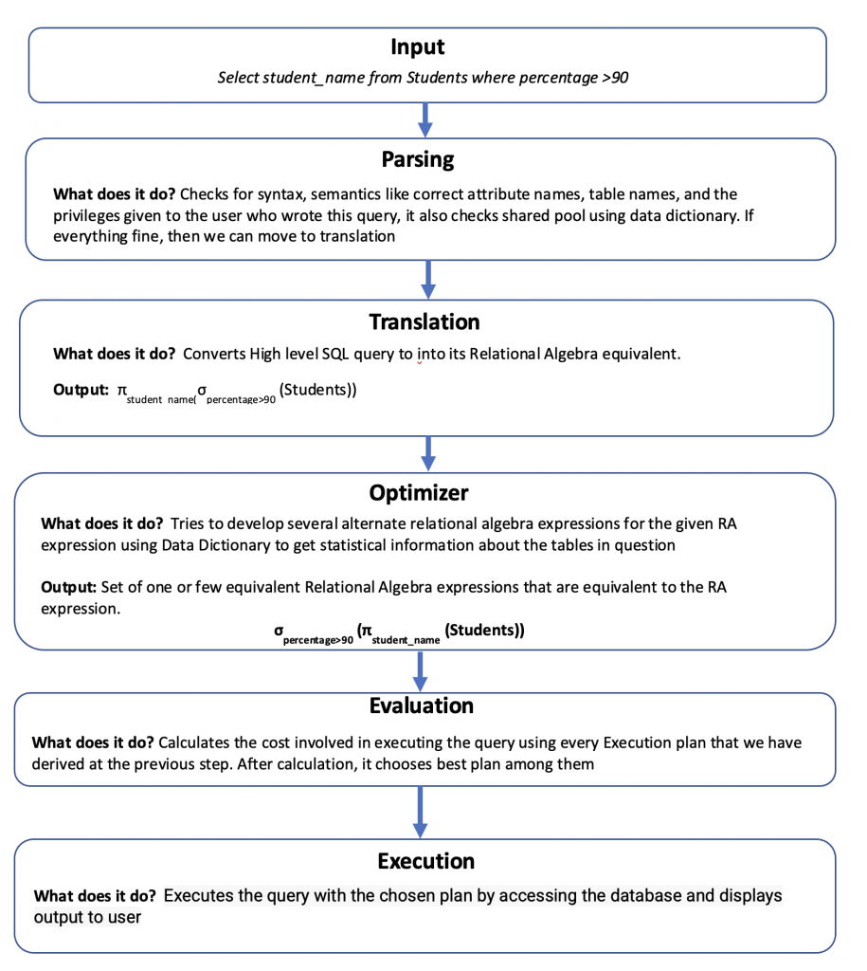
Query Processing and Query Optimization
Summary

